Slide 1
The Nature of the Vertical Distribution of Force Controlled Seismic Responses in Multi-Story Structures

Slide 2
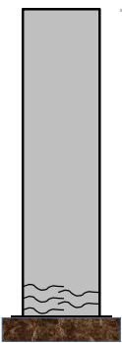
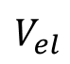
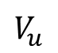
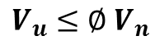
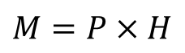
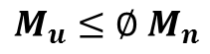
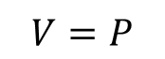
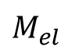
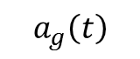
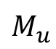
Force Definitions
FBDs
P
V, Shear
M, Moment
$$V_{u}≤∅ V_{n}$$
$$M_{u}≤∅ M_{n}$$
H
R
R
$$V=P$$
$$V_{u}$$
$$V_{el}$$
$$M_{u}$$
$$M_{el}$$
$$M=P×H$$
$$a_{g}\left(t\right)$$

Slide 3
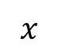
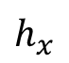
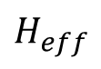
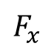

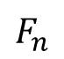
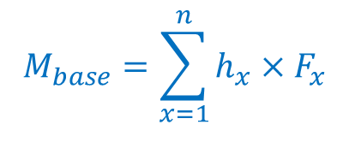
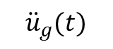
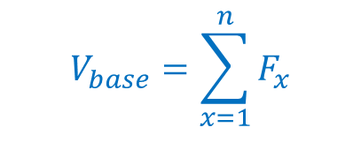
Force Definitions
FBDs
V, Shear
M, Moment
$$F_{n}$$
$$F_{x}$$
$$x$$
H
$$h_{x}$$
$$H_{eff}$$
$$V_{base}=\sum_{x=1}^{n}{F_{x}}$$
$$M_{base}=\sum_{x=1}^{n}{h_{x}×F_{x}}$$
$${\ddot{u}}_{g}(t)$$
$$H_{eff}=\frac{M_{base}}{V_{base}}$$

Slide 4
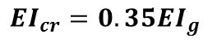
Shear Wall Building Analytical Models
Buildings:
24 Story
20 Story
16 Story
12 Story
8 Story
4 Story
Base Hinge Model
Fiber All Model
Design of Buildings Using ACI 318-11
$${EI}_{cr}=0.35{EI}_{g}$$
In OpenSees

Slide 5
Buildings Plan and Elevation

Slide 6
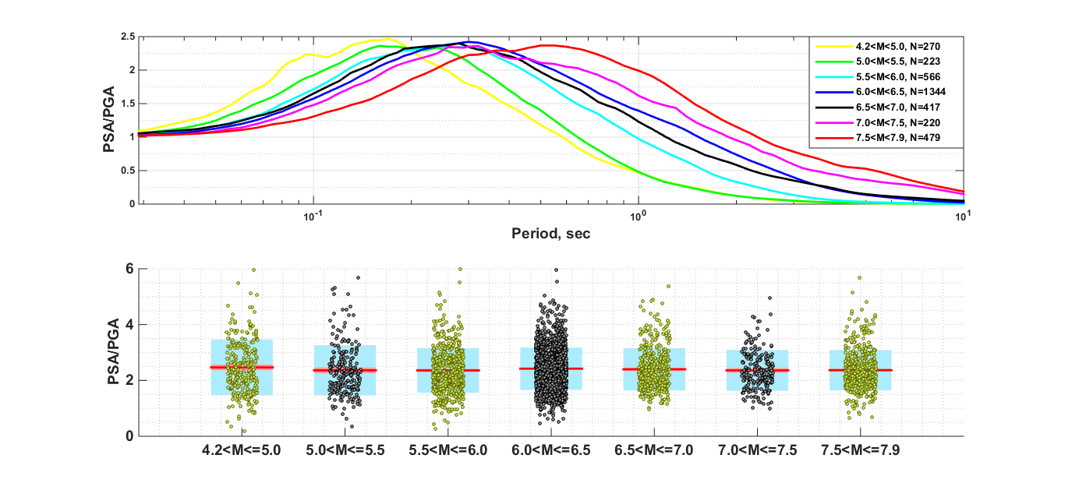
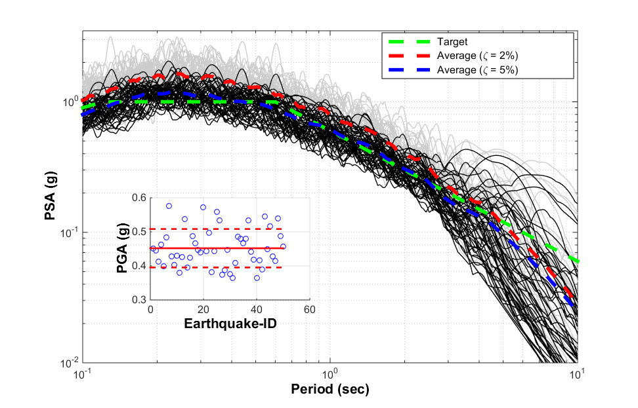
Ground Motion Database and Selection
Spectral Shape
Selection of 50 Earthquakes
Buildings
24 Story
20 Story
16 Story
12 Story
8 Story
4 Story
Design
Code
Const
Tapered
Hazard
Serv
DBE
MCE
Modeling
Base-Hinge
Fiber
50 EQs selected
50 x 6 x 3 x 3 x 2= 5400 runs
Use of HPC

Slide 7
Vertical distribution of floor forces at the peaks of each floor level

Slide 8
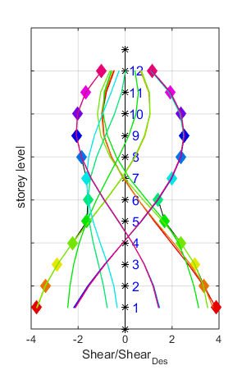
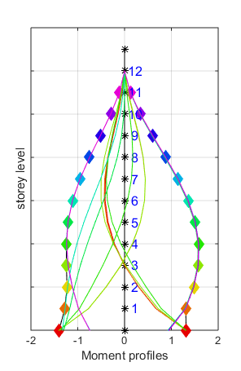
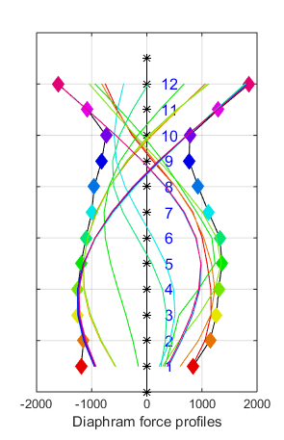
Moment and Diaphragm force when Shear is maximum at each floor

Slide 9
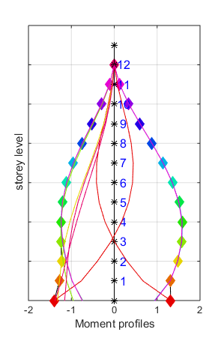
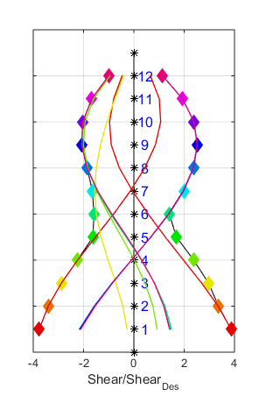
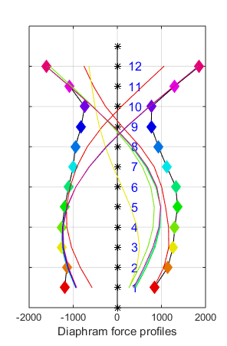
Shear and Diaphragm force when Moment is maximum at each floor

Slide 10
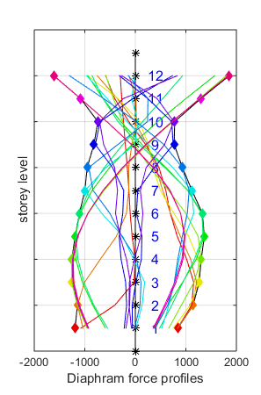
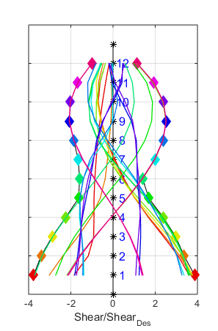
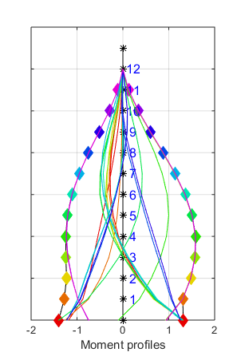
Shear and Moment when DiaForce is maximum at each floor

Slide 11
Vertical Distribution Patterns of Response Quantities: V, M, DiaF @MCE

Slide 12
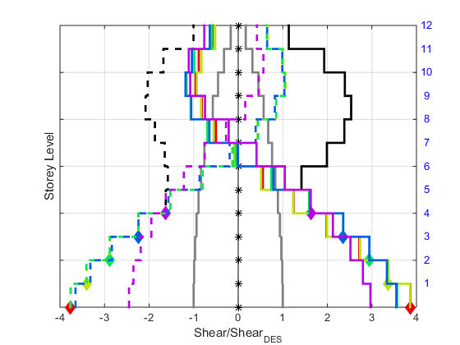
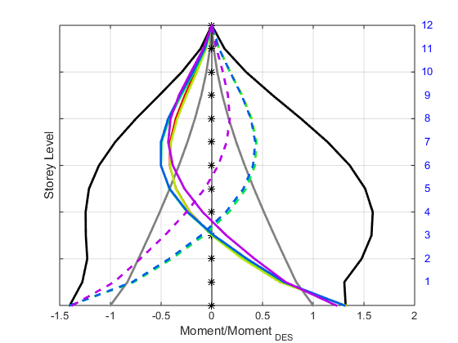
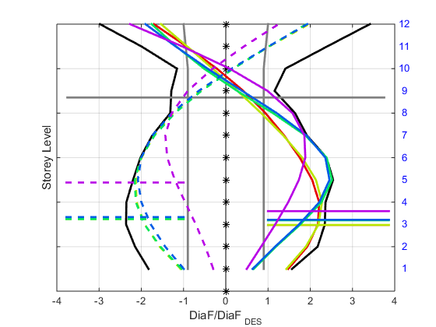
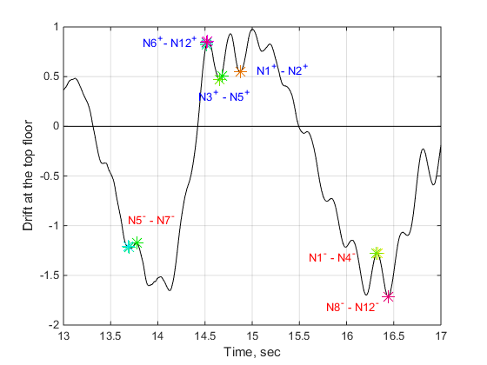
Moment and Diaphragm force when Shear is maximum at V1-V5

Slide 13
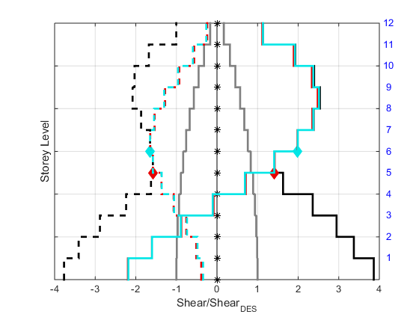
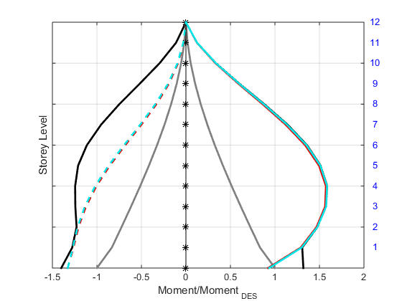
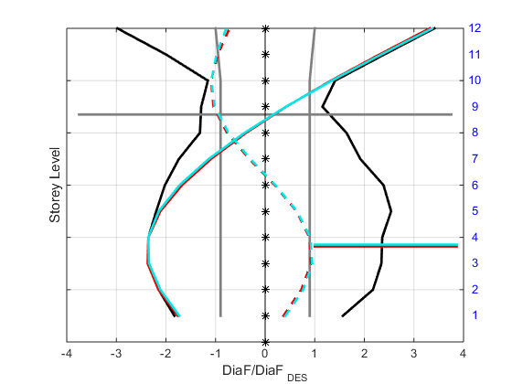
Moment and Diaphragm force when Shear is maximum at V6-V7

Slide 14
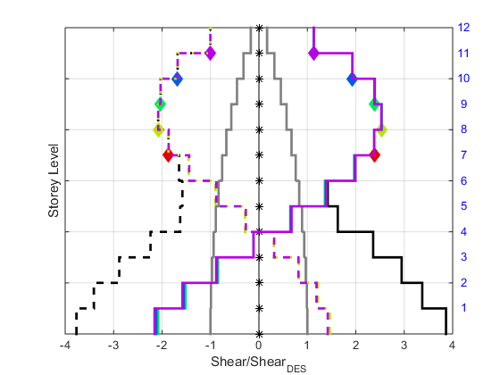
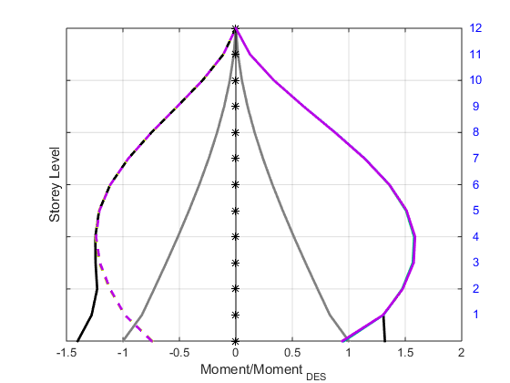
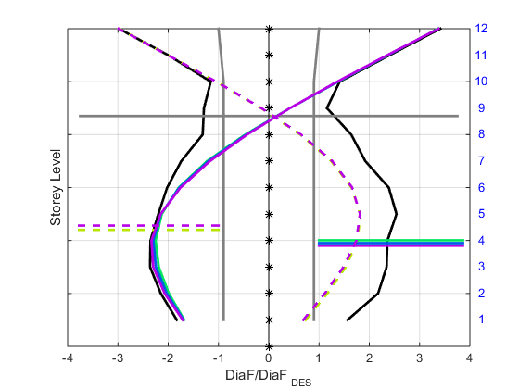
Moment and Diaphragm force when Shear is maximum at V8-V12

Slide 16
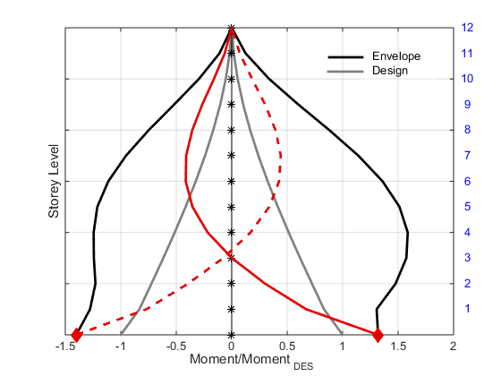
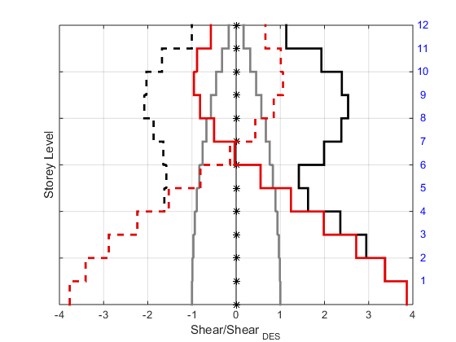
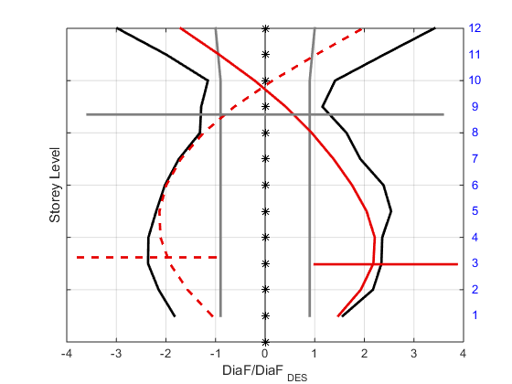
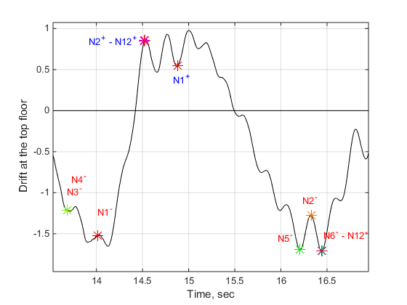
Shear and Diaphragm force when Moment is maximum at M1

Slide 17
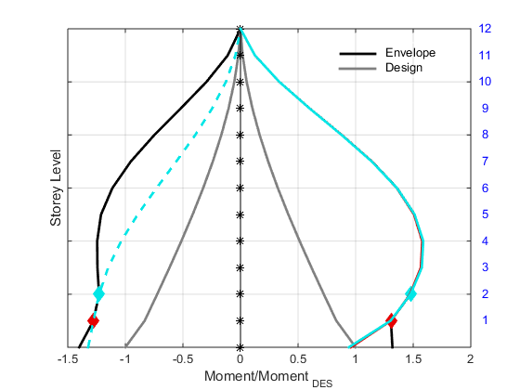
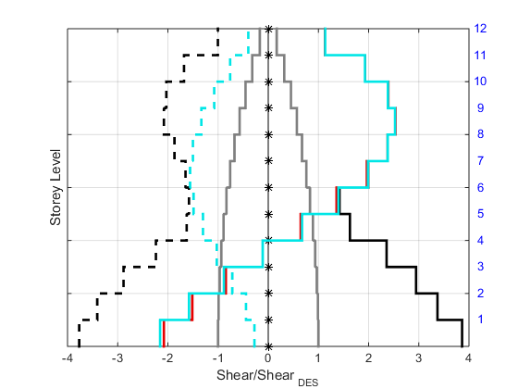
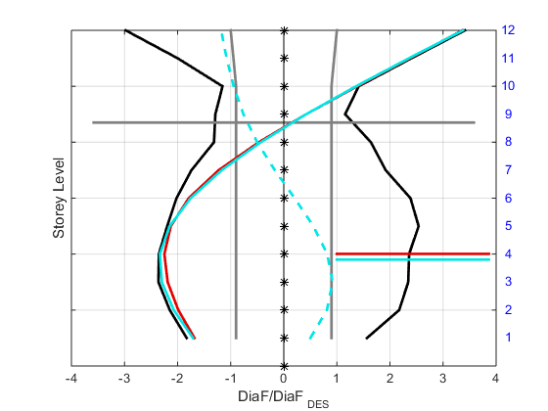
Shear and Diaphragm force when Moment is maximum at M2-M3

Slide 18
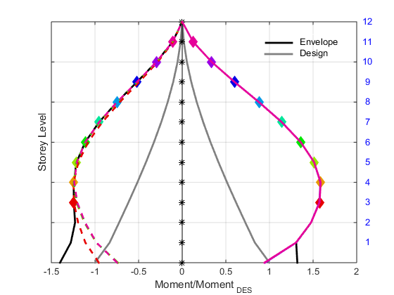
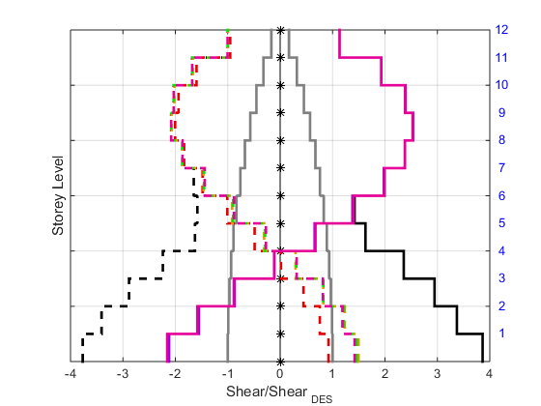
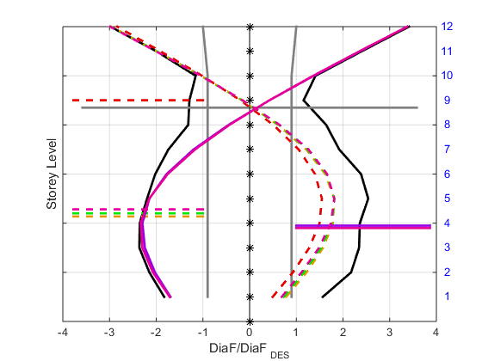
Shear and Diaphragm force when Moment is maximum at M4-M12

Slide 20




Moment and Shear force when DiaF is maximum at DiaF1-2

Slide 21



Moment and Shear force when DiaF is maximum at DiaF3-4

Slide 22



Moment and Shear force when DiaF is maximum at DiaF5-7

Slide 23



Moment and Shear force when DiaF is maximum at DiaF8-10

Slide 24



Moment and Shear force when DiaF is maximum at DiaF11-12

Slide 25

Results based on Instantaneous exceedance of design values
Results are obtained based on exceedance of design story shear, moment, and diaphragm force values
Shear Force Profiles when $V_{i}>V_{i,u}$
Diaphragm Force Profiles when ${diaF}_{i}>{diaF}_{i,u}$
Moment Force Profiles when $M_{i}>M_{i,u}$
where $i=1,2,3,…,N$ is floor level

Slide 26




Shear Profiles in each floor when Design Shear exceeded in ONE pulse - 12 Story Base-Hinge Model
Exceedance peak in one pulse

Slide 27


Shear Profiles in each floor when Design Shear exceeded in each cycle - 12 Story Base-Hinge Model

Slide 28



Shear Profiles in each floor when Design Shear exceeded in each cycle - 12 Story Base-Hinge Model
Negative
Positive

Slide 29



Shear Profiles in each floor when Design Shear exceeded in each cycle - 12 Story Base-Hinge Model
Negative
Positive

Slide 30



Shear Profiles in each floor when Design Shear exceeded in each cycle - 12 Story Base-Hinge Model
Negative
Positive

Slide 31



Shear Profiles in each floor when Design Shear exceeded in each cycle - 12 Story Base-Hinge Model
Negative
Positive

Slide 32



Shear Profiles in each floor when Design Shear exceeded in each cycle - 12 Story Base-Hinge Model
Negative
Positive

Slide 33



Shear Profiles in each floor when Design Shear exceeded in each cycle - 12 Story Base-Hinge Model
Negative
Positive

Slide 34



Shear Profiles in each floor when Design Shear exceeded in each cycle - 12 Story Base-Hinge Model
Negative
Positive

Slide 35



Shear Profiles in each floor when Design Shear exceeded in each cycle - 12 Story Base-Hinge Model
Negative
Positive

Slide 36



Shear Profiles in each floor when Design Shear exceeded in each cycle - 12 Story Base-Hinge Model
Negative
Positive

Slide 37



Shear Profiles in each floor when Design Shear exceeded in each cycle - 12 Story Base-Hinge Model
Negative
Positive

Slide 38



Shear Profiles in each floor when Design Shear exceeded in each cycle - 12 Story Base-Hinge Model
Negative
Positive

Slide 39



Shear Profiles in each floor when Design Shear exceeded in each cycle - 12 Story Base-Hinge Model
Negative
Positive

Slide 40



Shear Profiles in each floor when Design Shear exceeded in each cycle - 12 Story Base-Hinge Model
Negative
Positive

Slide 41



Shear Profiles in each floor when Design Shear exceeded in each cycle - 12 Story Base-Hinge Model
Negative
Positive

Slide 42



Shear Profiles in each floor when Design Shear exceeded in each cycle - 12 Story Base-Hinge Model
Negative
Positive

Slide 43



Shear Profiles in each floor when Design Shear exceeded in each cycle - 12 Story Base-Hinge Model
Negative
Positive

Slide 44



Shear Profiles in each floor when Design Shear exceeded in each cycle - 12 Story Base-Hinge Model
Negative
Positive

Slide 45



Shear Profiles in each floor when Design Shear exceeded in each cycle - 12 Story Base-Hinge Model
Negative
Positive

Slide 46



Shear Profiles in each floor when Design Shear exceeded in each cycle - 12 Story Base-Hinge Model
Negative
Positive

Slide 47



Shear Profiles in each floor when Design Shear exceeded in each cycle - 12 Story Base-Hinge Model
Negative
Positive

Slide 48



Shear Profiles in each floor when Design Shear exceeded in each cycle - 12 Story Base-Hinge Model
Negative
Positive

Slide 49



Shear Profiles in each floor when Design Shear exceeded in each cycle - 12 Story Base-Hinge Model
Negative
Positive

Slide 50



Shear Profiles in each floor when Design Shear exceeded in each cycle - 12 Story Base-Hinge Model
Negative
Positive

Slide 51



Shear Profiles in each floor when Design Shear exceeded in each cycle - 12 Story Base-Hinge Model
Negative
Positive

Slide 52



Shear Profiles in each floor when Design Shear exceeded in each cycle - 12 Story Base-Hinge Model
Negative
Positive

Slide 53



Shear Profiles in each floor when Design Shear exceeded in each cycle - 12 Story Base-Hinge Model
Negative
Positive

Slide 54



Shear Profiles in each floor when Design Shear exceeded in each cycle - 12 Story Base-Hinge Model
Negative
Positive

Slide 55



Shear Profiles in each floor when Design Shear exceeded in each cycle - 12 Story Base-Hinge Model
Negative
Positive

Slide 56



Shear Profiles in each floor when Design Shear exceeded in each cycle - 12 Story Base-Hinge Model
Negative
Positive

Slide 57



Shear Profiles in each floor when Design Shear exceeded in each cycle - 12 Story Base-Hinge Model
Negative
Positive

Slide 58



Shear Profiles in each floor when Design Shear exceeded in each cycle - 12 Story Base-Hinge Model
Negative
Positive

Slide 59


Shear Profiles in each floor when Design Shear exceeded in each cycle - 12 Story Base-Hinge Model
Negative
Positive

Slide 60



Shear Profiles in each floor when Design Shear exceeded in each cycle - 12 Story Base-Hinge Model
Negative
Positive

Slide 61



Shear Profiles in each floor when Design Shear exceeded in each cycle - 12 Story Base-Hinge Model
Negative
Positive

Slide 62



Shear Profiles in each floor when Design Shear exceeded in each cycle - 12 Story Base-Hinge Model
Negative
Positive

Slide 63



Shear Profiles in each floor when Design Shear exceeded in each cycle - 12 Story Base-Hinge Model
Negative
Positive

Slide 64
Effective Height Calculation

Slide 65


Shear Profiles in each floor when Design Shear exceeded in ONE pulse - 12 Story Base-Hinge Model

Slide 66


Number of incidents that forces exceeded design Vu
Exceedance Continuously
Exceedance peak in one pulse

Slide 67



Shear Profiles in each floor when Design Shear exceeded - 12 Story Base-Hinge Model
Effective Height when $V_{base}=V_{1}>V_{base,u}$
To avoid too large H*, $V_{base}=V_{1}>0.5 V_{base,u}$ threshold is imposed

Slide 68


Shear Profiles in each floor when Design Shear exceeded - 12 Story Base-Hinge Model
Effective Height when $V_{2}>V_{2,u}$
To avoid too large H*, $V_{base}=V_{1}>0.5 V_{base,u}$ threshold is imposed

Slide 69


Shear Profiles in each floor when Design Shear exceeded - 12 Story Base-Hinge Model
Effective Height when $V_{3}>V_{3,u}$
To avoid too large H*, $V_{base}=V_{1}>0.5 V_{base,u}$ threshold is imposed

Slide 70


Shear Profiles in each floor when Design Shear exceeded - 12 Story Base-Hinge Model
Effective Height when $V_{4}>V_{4,u}$
To avoid too large H*, $V_{base}=V_{1}>0.5 V_{base,u}$ threshold is imposed
Standard Deviation is getting big: is there much data out of screen?
Next Slide

Slide 71


Shear Profiles in each floor when Design Shear exceeded - 12 Story Base-Hinge Model
Effective Height when $V_{4}>V_{4,u}$
To avoid too large H*, $V_{base}=V_{1}>0.5 V_{base,u}$ threshold is imposed

Slide 72


Shear Profiles in each floor when Design Shear exceeded - 12 Story Base-Hinge Model
Effective Height when $V_{5}>V_{5,u}$
To avoid too large H*, $V_{base}=V_{1}>0.5 V_{base,u}$ threshold is imposed

Slide 73


Shear Profiles in each floor when Design Shear exceeded - 12 Story Base-Hinge Model
Effective Height when $V_{6}>V_{6,u}$
To avoid too large H*, $V_{base}=V_{1}>0.5 V_{base,u}$ threshold is imposed

Slide 74


Shear Profiles in each floor when Design Shear exceeded - 12 Story Base-Hinge Model
Effective Height when $V_{7}>V_{7,u}$
To avoid too large H*, $V_{base}=V_{1}>0.5 V_{base,u}$ threshold is imposed

Slide 75


Shear Profiles in each floor when Design Shear exceeded - 12 Story Base-Hinge Model
Effective Height when $V_{8}>V_{8,u}$
To avoid too large H*, $V_{base}=V_{1}>0.5 V_{base,u}$ threshold is imposed

Slide 76


Shear Profiles in each floor when Design Shear exceeded - 12 Story Base-Hinge Model
Effective Height when $V_{9}>V_{9,u}$
To avoid too large H*, $V_{base}=V_{1}>0.5 V_{base,u}$ threshold is imposed

Slide 77


Shear Profiles in each floor when Design Shear exceeded - 12 Story Base-Hinge Model
Effective Height when $V_{10}>V_{10,u}$
To avoid too large H*, $V_{base}=V_{1}>0.5 V_{base,u}$ threshold is imposed

Slide 78


Shear Profiles in each floor when Design Shear exceeded - 12 Story Base-Hinge Model
Effective Height when $V_{11}>V_{11,u}$
To avoid too large H*, $V_{base}=V_{1}>0.5 V_{base,u}$ threshold is imposed

Slide 79


Shear Profiles in each floor when Design Shear exceeded - 12 Story Base-Hinge Model
Effective Height when $V_{12}>V_{12,u}$
To avoid too large H*, $V_{base}=V_{1}>0.5 V_{base,u}$ threshold is imposed

Slide 80












$$V_{1}>V_{1,u}$$
$$V_{2}>V_{2,u}$$
$$V_{3}>V_{3,u}$$
$$V_{4}>V_{4,u}$$
$$V_{5}>V_{5,u}$$
$$V_{6}>V_{6,u}$$
$$V_{7}>V_{7,u}$$
$$V_{8}>V_{8,u}$$
$$V_{9}>V_{9,u}$$
$$V_{10}>V_{10,u}$$
$$V_{11}>V_{11,u}$$
$$V_{12}>V_{12,u}$$

Slide 81








$$V_{1}>V_{1,u}$$
$$V_{2}>V_{2,u}$$
$$V_{4}>V_{4,u}$$
$$V_{3}>V_{3,u}$$
$$V_{5}>V_{5,u}$$
$$V_{8}>V_{8,u}$$
$$V_{6}>V_{6,u}$$
$$V_{7}>V_{7,u}$$
$$V_{11}>V_{11,u}$$
$$V_{12}>V_{12,u}$$
$$V_{9}>V_{9,u}$$
$$V_{10}>V_{10,u}$$

Slide 82



















$$V_{1}>V_{1,u}$$
$$V_{2}>V_{2,u}$$
$$V_{3}>V_{3,u}$$
$$V_{4}>V_{4,u}$$
$$V_{5}>V_{5,u}$$
$$V_{6}>V_{6,u}$$
$$V_{7}>V_{7,u}$$
$$V_{8}>V_{8,u}$$
$$V_{11}>V_{11,u}$$
$$V_{12}>V_{12,u}$$
$$V_{9}>V_{9,u}$$
$$V_{10}>V_{10,u}$$

Slide 83












$$V_{1}>V_{1,u}$$
$$V_{2}>V_{2,u}$$
$$V_{3}>V_{3,u}$$
$$V_{4}>V_{4,u}$$
$$V_{5}>V_{5,u}$$
$$V_{6}>V_{6,u}$$
$$V_{7}>V_{7,u}$$
$$V_{8}>V_{8,u}$$
$$V_{11}>V_{11,u}$$
$$V_{12}>V_{12,u}$$
$$V_{9}>V_{9,u}$$
$$V_{10}>V_{10,u}$$

Slide 84
Effective height by taking average of results from 50 earthquakes

Slide 85




12 story Base Hinge Model
DBE
MCE

Slide 86




4 story Base Hinge Model
DBE
MCE

Slide 87




12 story Fiber Model
DBE
MCE

Slide 88






12 Story Base-Hinge Model, @ DBE & MCE
Effective Height when $F_{12}>F_{12,u}$
To avoid too large H*, $V_{base}>0.5 V_{base,u}$
$$V_{base}>0.5 V_{base,u}$$
DBE
$$V_{base}>0.1 V_{base,u}$$

Slide 89



Exceedance of Base Shear - 12 Story Base-Hinge Model @MCE
Color spectrum is based on this figure
Period12story, $T_{1}=1.17$ secs

Slide 90






12 Story Base-Hinge Model @MCE
Weighted Average Calculation
$$Case V_{base}>V_{base,u}$$
Ave H* @Vmax of each EQ
Weig Ave H* based on Pulse Dur
Ave H* All

Slide 91



Exceedance of Roof Force - 12 Story Base-Hinge Model @MCE
To avoid too large H*
Color spectrum is based on this figure
$$V_{base}>0.1 V_{base,u}$$

Slide 92








12 Story Base-Hinge Model @MCE
$$Case F_{top}>F_{top,u}$$
Weighted Average Calculation
To avoid too large H*, $V_{base}>0.1 V_{base,u}$
Ave H* All
Ave H* @Fmax of each EQ
Weig Ave H* based on Pulse Duration
$$μ=0.58$$
$$σ=1.02$$
$$μ=0.32$$
$$σ=0.7$$
$μ=0.$68
$$σ=0.24$$

Slide 93
Progress
Preliminary study:
For simplest case (e.g., 8 story hinge model) use processed data to visualize responses
Visualizing the data
Finding the correlation b/w different quantities and occurrences

Slide 94

“Simulation Tool” to observe vertical distribution of forces and deformations

